Slide 1

Music Genre Classification
with Convolutional Recurrent Neural Network
Campana Luca Liturri Gianvito Padovano Dario
MLDL A.A 2020/2021
s290085 s290464 s291475

Slide 2
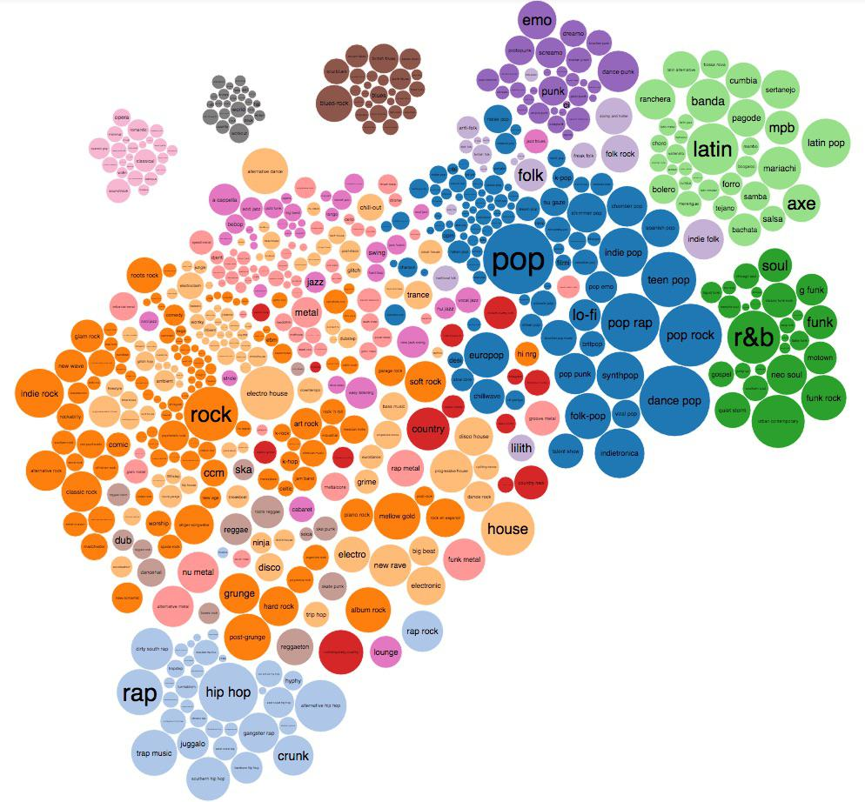
Introduction – Problem overview
Task: Music Genre Classification
Challenging data representations (handling high-dimensional data)
Possible advantages for music industry

Slide 3
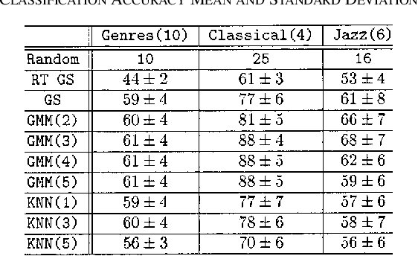
Related Work (1/2)
G. Tzanetakis and P. Cook, “Musical genre classification of audio signals”
GTZAN – a dataset for our task
Features based model
Simple model approaches
Starting baseline

Slide 4
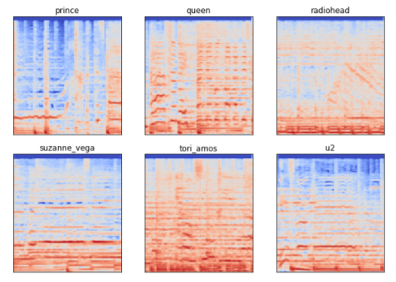
Related Work (2/2)
Z. Nasrullah and Y. Zhao, “Music artist classification with convolutional recurrent neural networks”
Similar approach, different task
Spectrogram based model
Slice based evaluation (majority vote)

Slide 5
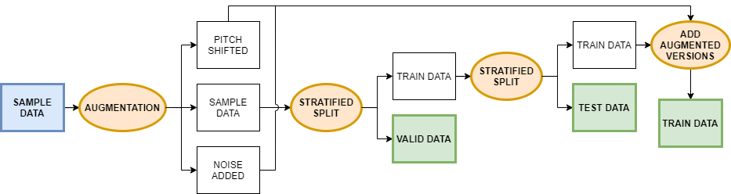
Method (1/4) – Dataset & Pre-processing
GTZAN: 1000 songs, 10 distinct genres
Data augmentation: pitch shift and noise addiction
Accurate split over training, validation and test sets

Slide 6
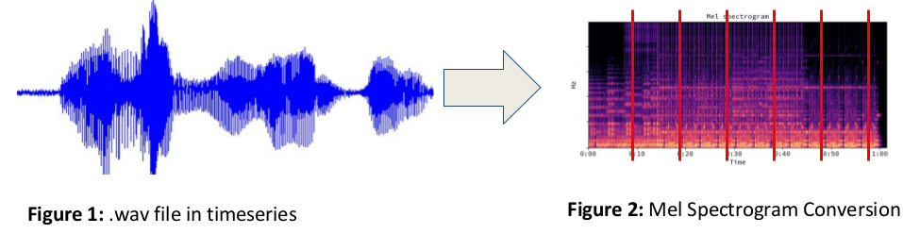

Method (2/4) – Dataset & Pre-processing
Mel-Spectrogram computation
Slice into time intervals (six fixed lengths)
1 2 3 4 5 6
and slicing

Slide 7
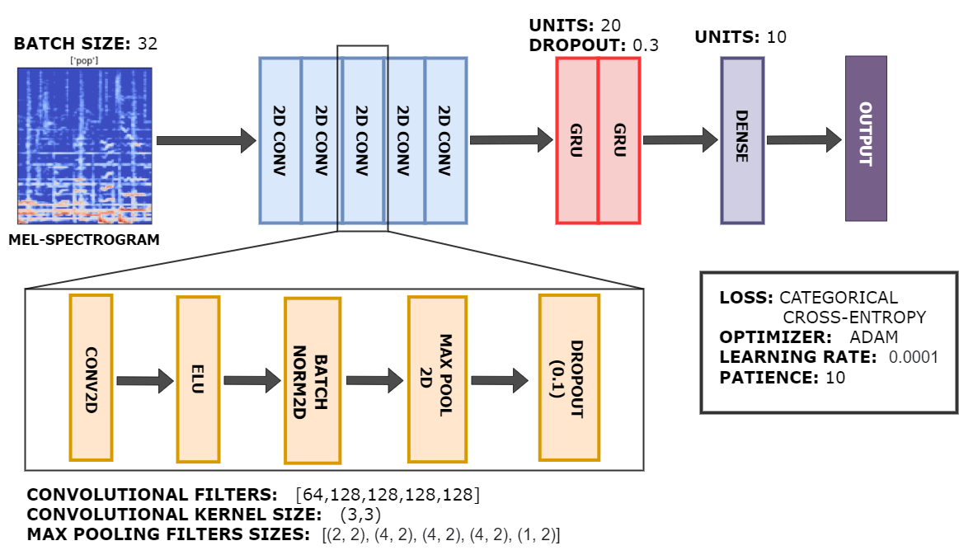
Method (3/4) – Architecture

Slide 8
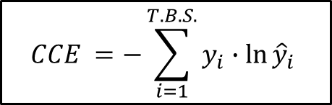
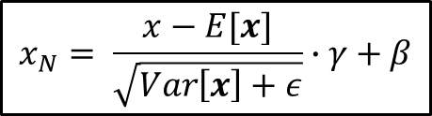
Method (4/4) – Regularization & Backpropagation
Regularization techniques: Dropout + 2D Batch normalization
Loss: Categorical Cross-Entropy
Optimizer: ADAM
$$x_{N}= \frac{x−E[x]}{\sqrt{Var\left[x\right]+ε}}∙γ+β$$
$$CCE =−\sum_{i=1}^{T.B.S.}{y_{i}∙\ln{{\hat{y}}_{i}} }$$

Slide 9
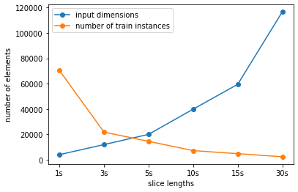
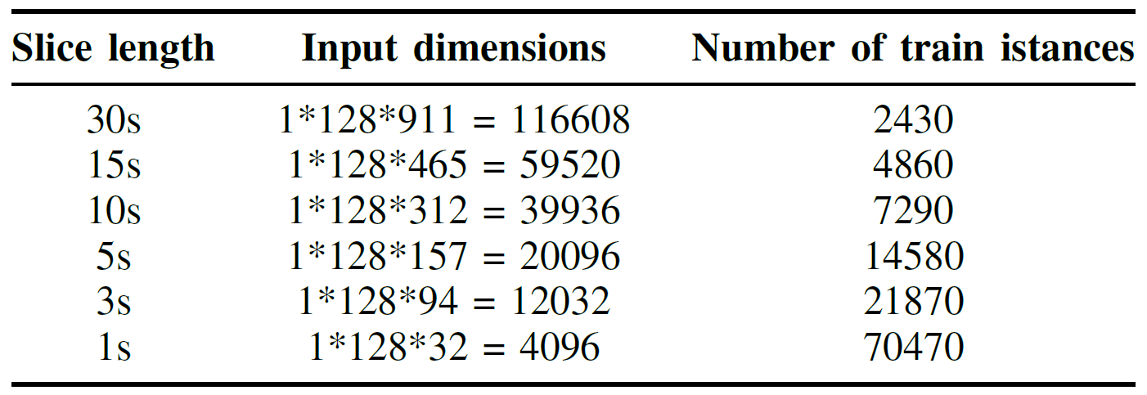
Results (1/5) – Curse of Dimensionality on Slice Lengths
Longer slice ↔ larger input dimensions, smaller training dataset
Issues for all slices ≥ 3 sec
Is the shortest always the better? Trade-off required?

Slide 10
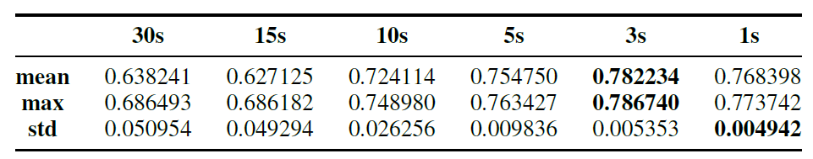
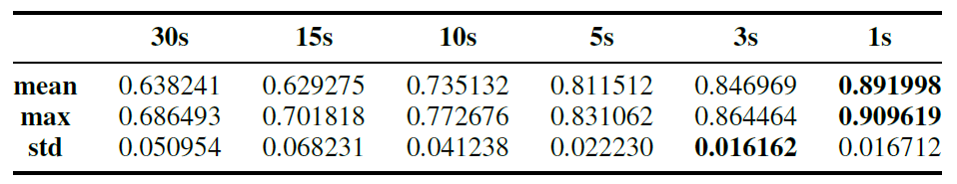
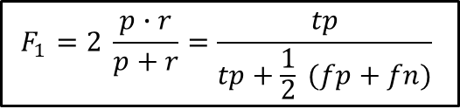
Results (2/5) – Grid Search on Slice Lengths
Chosen metric: F₁ Score
Frame-level evaluation:
Song-level evaluation:
$$F_{1}=2 \frac{p∙r}{p+r}=\frac{tp}{tp+\frac{1}{2} (fp+fn)}$$

Slide 11
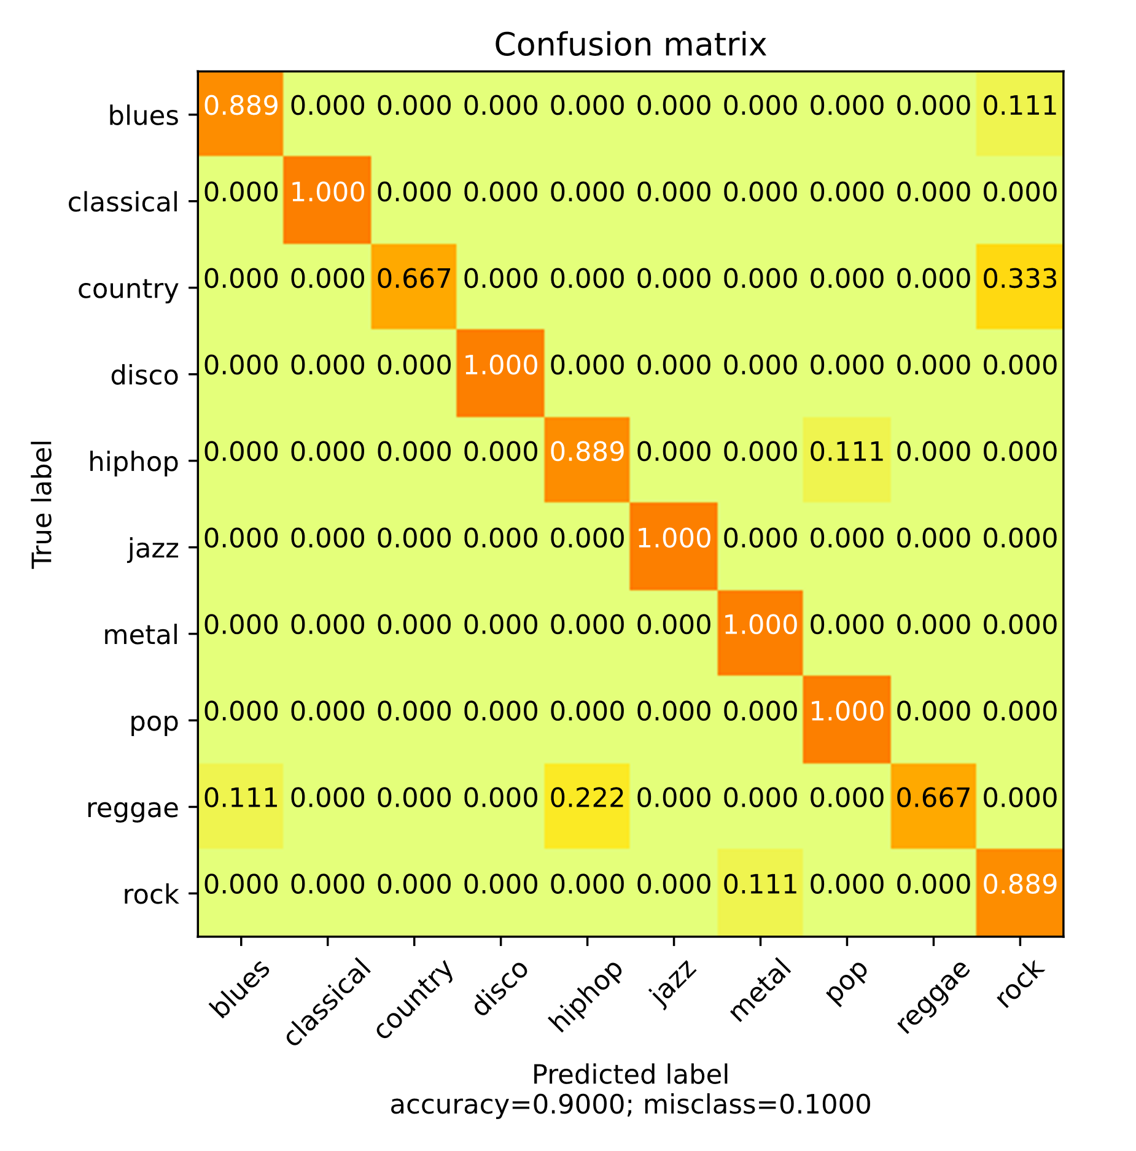
Results (3/5) – Final run & Quality Visualization
100% accuracy for 5 classes out of 10
90% overall accuracy
Extra: Top-2 and Top-3 evaluation
F₁ = 0,9562
F₁ = 0,9888

Slide 12
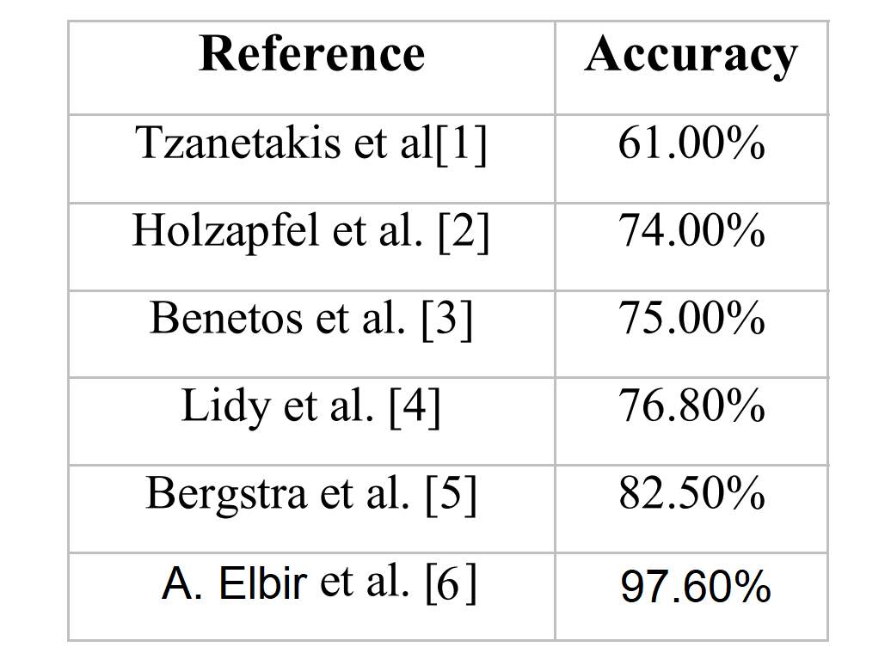
Results (4/5) – Baseline & State-of-Art Comparison
[1] Tzanetakis, G. and Cook, P. “Musical genre classification of audio signals”
[2] Holzapfel, A. and Stylianou, Y. “Musical genre classification using nonnegative matrix factorization-based features”
[3] Benetos, E. and Kotropoulos, C. “A tensor-based approach for automatic music genre classification”
[4] Lidy, T., Rauber, A., Pertusa, A. and Inesta, J. “Combining audio and symbolic descriptors for music classification from audio”
[5] Bergstra, J., Casagrande, N., Erhan, D., Eck, D. and Kegl B. “Aggregate features and AdaBoost for music classification”
[6] Elbir, A. and Aydin, N. "Music genre classification and music recommendation by using deep learning"
Elbir
97.60%

Slide 13
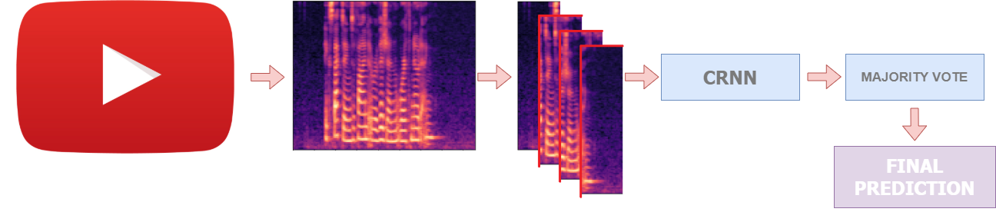
Results (5/5) – Model application to YouTube extracts
Simulated deployment: YouTube as real-case scenario
Algorithm applied on 2 unseen songs
Successful results

Slide 14
Conclusions & Contributions
CRNN understands its application domain better than feature-based models, basing on the same data → Temporal structure matters!
Adequate behavior in real-case scenarios
Future directions: augmentation through masking frequencies, overlapping time slices, extension of already implemented augmentations
Possible source of inspiration for further researches

